Slide 1




Presented By: Ankita Thomas
Analyzing NYC Jobs Datasets

Slide 2
Motivation Behind Analysis
The decision to analyze NYC Jobs datasets was driven by the need to gain deeper insights into the city's job market dynamics. Understanding trends in job postings, different agencies, salary.
Data Source
WEBSITE: DATA.GOV
Link:https://catalog.data.gov/dataset/nyc-jobs/resource/ab4444d9-85a6-4946-a0ef-3d3638485de8

Slide 3

About the Dataset
The Dataset includes:
6548 Rows and 30 Columns
Each row details a job posted by various city agencies.
Each posting specifies public or internal job availability.
Dataset was cleaned, Null columns were removed, used Regex to clean Residency Requirement where 95 unique values were used just to indicate 3 things a) NY residency must b) NY Residency not required, c) NY Residency required after certain amount of time.

Slide 4
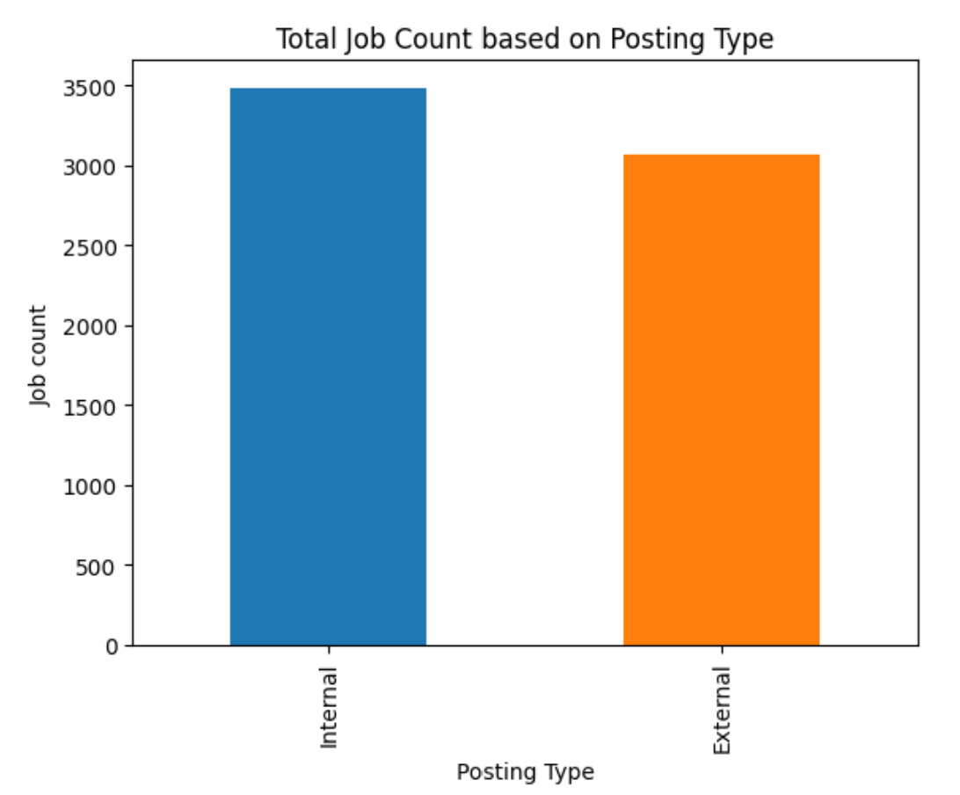
Interestingly, there were around 3500 positions for internal candidates, while nearly 3000 jobs were open to external applicants from the public.

Slide 5
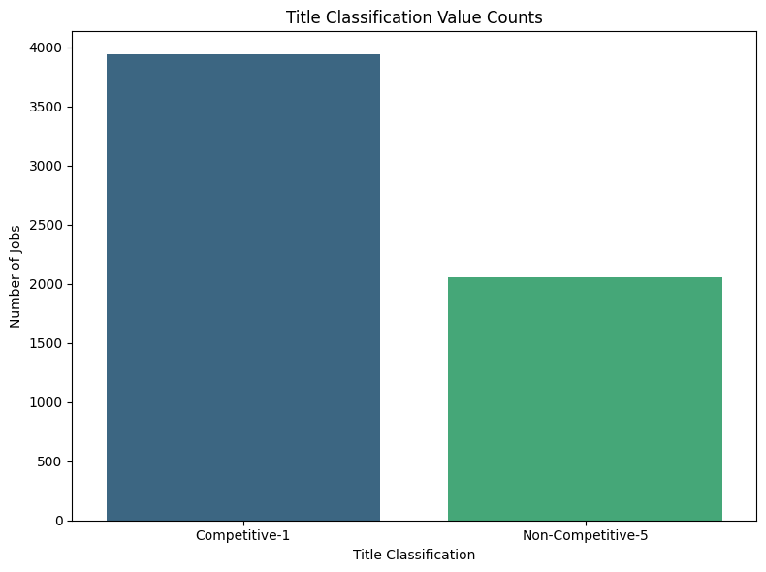
Majority of the Jobs are Competitive and nearly one-third of jobs are Non-Competitive, selection based on Experience, Qualifications & skills.

Slide 6
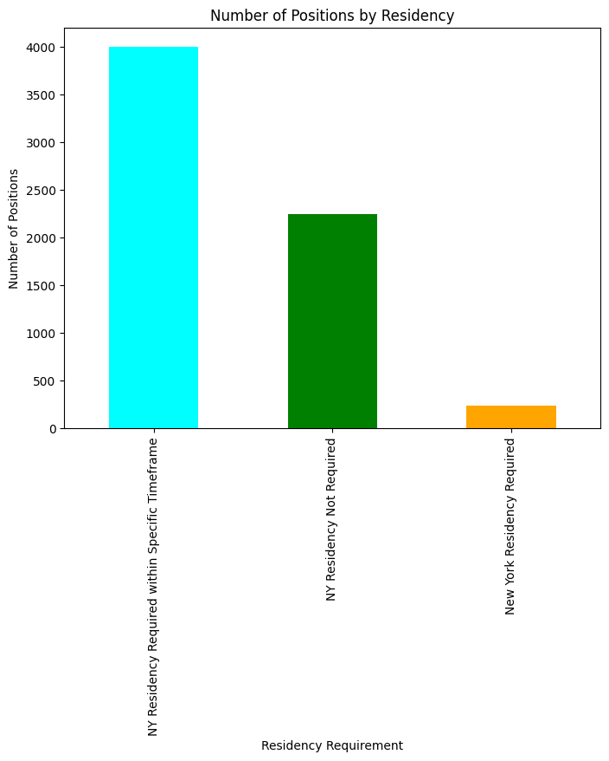
The analysis reveals strong competition, as many jobs Don't require NY residency or ask for it after around 90 days.
Can also mean diversity in a work environment.
The number of jobs with immediate residency requirements is relatively low.

Slide 7
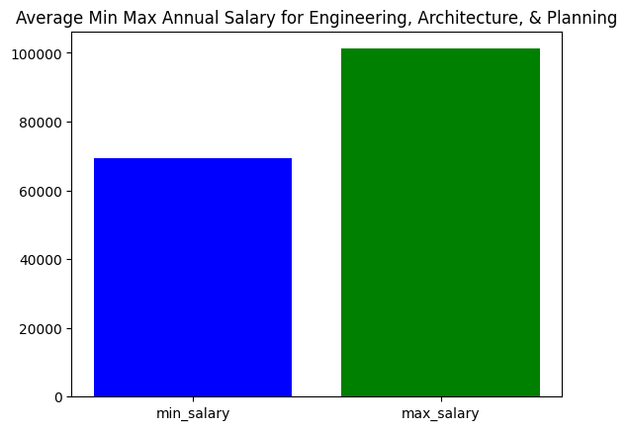
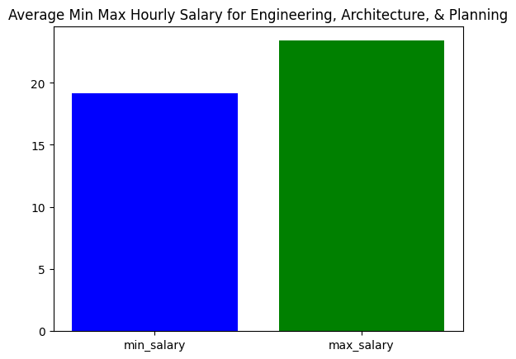
Minimum and Maximum salary for Engineering, Architecture, and Planning job category both Annually and Hourly.

Slide 8
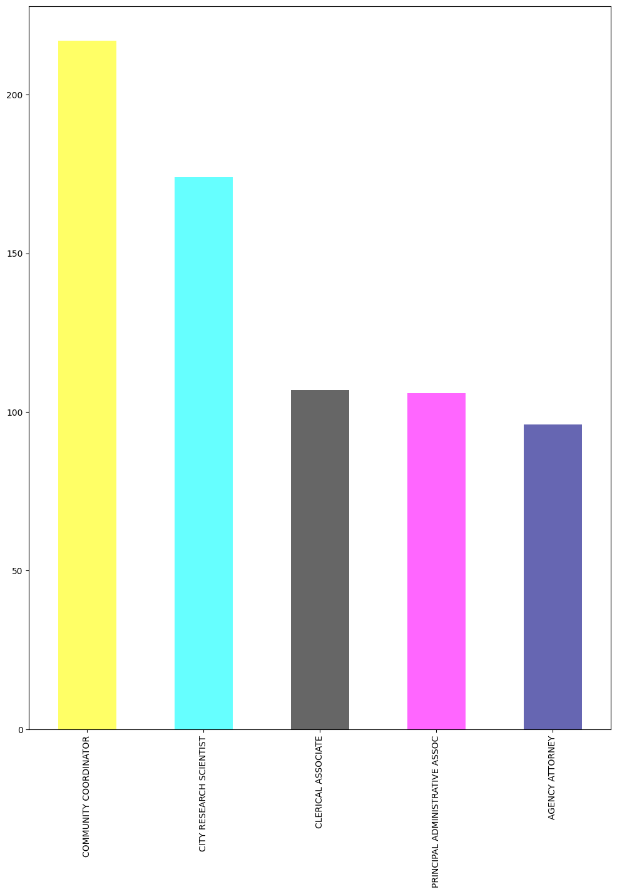
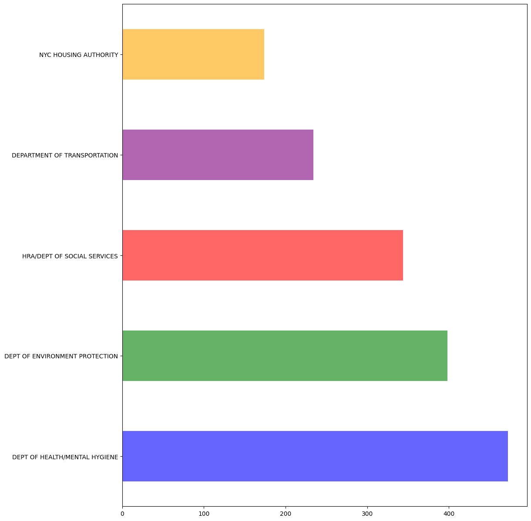
Among the Job Titles- Community Coordinator, City Research Scientist have most vacancies. Among the agencies-Dept of Mental Hygiene has the most vacancies followed by Dept of Environmental Protection

Slide 9
Conclusion
NYC JOB MARKET is very diversified
Almost equal opportunities for General Public as well as Internal Employees
Most Jobs have relaxed NY residency rules which invites diversity at the same time, competition.
Highest vacancies in Mental Health & Hygiene and an equal need for City Research Scientist underscores 2 things:
Critical need for more workforce within Healthcare
City realizes the importance of a Data Driven Decision and Analytics and is welcoming more people with opportunities.

Slide 10
THANK YOU!

